Slide 1
MINING & MINERAL PROCESSING
GOLD mining and extraction in SA

Slide 2
INTRODUCTION
Why is GOLD valuable and worth mining
Where is GOLD found in South Africa
How is GOLD mined
How is GOLD extracted

Slide 3
WHY IS GOLD valuable and worth mining
Gold has unique physical and chemical characteristics that made it valuable. These are:
Malleable and ductile
Shiny
Durable
Good conductor
Heat ray reflector
Thus it is used for…

Slide 4
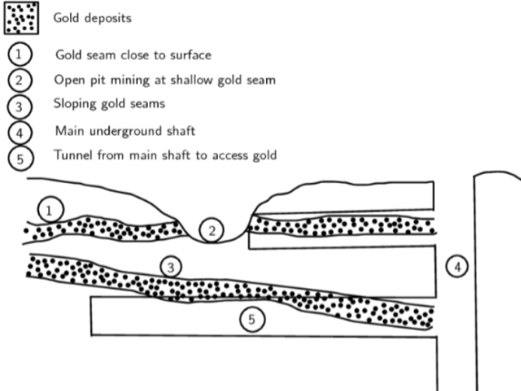
WHERE IS GOLD FOUND IN S.A
Most of the South African gold is concentrated in the Golden Arc which stretches from Johannesburg to Welkom.

Slide 5
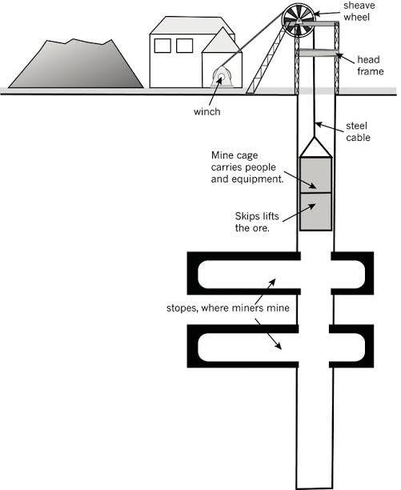
HOW IS GOLD MINED (underground mining)

Slide 6
Cont.
Exploration
Construction
Underground mining:
Planning
Drilling
Blasting and hauling
Transporting

Slide 7
PROCESSING THE GOLD ORE (GOLD CYANIDATION)
STEP 1: (gold-bearing ore)
Gold is crushed into fine powder
STEP 2: (gold cyanidation)
(4Au+8NaCN+O2+2H2O 4NaAu(CN) + 4NaOH)
Sodium cyanide solution is mixed with the fine powder. Gold is oxidised

Slide 8
Cont.
STEP 3: (gold-precipitate)
Gold bearing solution is separated from the remaining solid ore through filtration.
STEP 4: (Pure gold) Zinc is added. Zinc replaces the gold in the gold-cyanide solution. Reduction reaction takes place at this stage.

Slide 9

Conclusion

Slide 10
Class activity
Name the layer of the earth in which the gold mineral is found
State three methods in which gold can be mined
What is the function of the zinc powder when extracting gold from an ore
Draw a flow diagram representing the process of extracting gold using gold cyanidation method

